Slide 1
ELEC S212 (Sept. 2018)
Network
Programming and Design
Tutorial 8
(Review of IP addressing & How to subnet)
Course Coordinator : Dr. Steven Choy
Tutor : Mr. Joe Lee
URL of my teaching website : http://learn.ouhk.edu.hk/~t441051/s212
P.<number>
Notes:
CT212 (02/03)-Network Programming and design
27 April, 2002
School of Science & Technology

Slide 2
Agenda for Tutorial 8
What is IP address
What is default network mask
How to subnet
  IP address for a network
  IP address for a subnet
  IP address for broadcast address of a network
  IP address for broadcast address of a subnet
  Default network mask Vs subnet mask
P.<number>
Notes:
CT212 (02/03)-Network Programming and design
27 April, 2002
School of Science & Technology

Slide 3
IP address (1)
32 bit for IPv4;
128 bit for IPv6
In INTERNET, IP address uniquely identify
    interface
    host
    network (eg. 131.21.0.0)
    Subnet (eg. 131.21. 4.0)
    Broadcast address for network or subnet (eg. 131.21.255. 255 or 131.21.4.255)
P.<number>
Notes:
CT212 (02/03)-Network Programming and design
27 April, 2002
School of Science & Technology

Slide 4
IP Address (2)
IP-v4 classful address :
  2 formats :
    Decimal : 192.123.44.23 (note each field between period is 0 ~ 255), more convenient
    Binary : 11000000.01111011.00110100.00010111
  Composed of 2 portions – network portion, host portion
  All hosts of same network must have same value on network portion
  Based on first 4 bits (MSB) of IP address, it is classified into 5 classes : class A through E. Only Class A through C can be assigned to a machine/host.
P.<number>
Notes:
CT212 (02/03)-Network Programming and design
27 April, 2002
School of Science & Technology

Slide 5
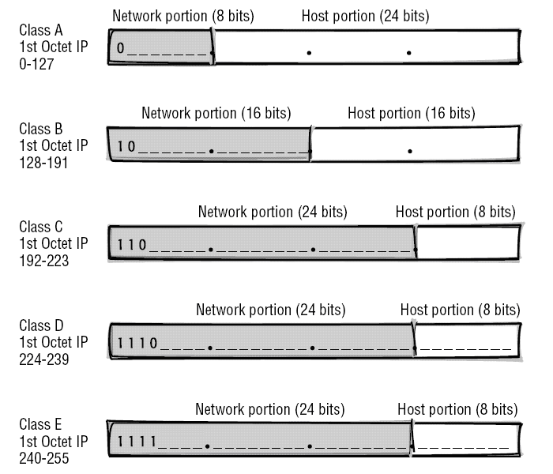
IP Address (2)
Origins of the Internet • Internet Reference Model • Internet Protocol • IP Routing • TCP • UDP

Slide 6
Default network mask
Network mask is used to specify which part of an IP address is network-portion.
Consecutive bit of value “1” specify corresponding bit as network portion
Class | (Default) network mask
A | 255.0.0.0
B | 255.255.0.0
C | 255.255.255.0
P.<number>
Notes:
CT212 (02/03)-Network Programming and design
27 April, 2002
School of Science & Technology

Slide 7
Reserved IP Address
Reserved IP addresses :
  used as src. address in BOOTP
    0.0.0.0
    All zeros on network portion
  Loopback address - 127.x.x.x
  Specify a network : All zeros on host portion
  Broadcast address :
    All 1s on host portion
    255.255.255.255
  Class D & E
P.<number>
Notes:
CT212 (02/03)-Network Programming and design
27 April, 2002
School of Science & Technology

Slide 8
IP Subnet (1)
What is sub-netting?
  Divide a large network into a number of smaller subnets
  Each subnet is also a network, a broadcast domain. Subnets are connected by router (not hub/LAN switch)
How to sub-net?
  Network mask changes to subnet mask
  extends continuous ones towards right to host portion. The extension part is called subnet portion. The network mask is now called subnet mask.
Each IP address now consists of 3 portions
  Network, subnet, host portion
P.<number>
Notes:
CT212 (02/03)-Network Programming and design
27 April, 2002
School of Science & Technology

Slide 9
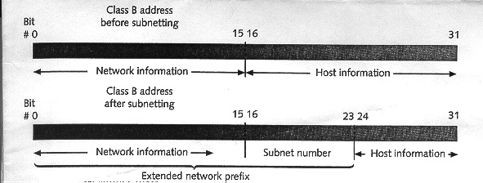
IP Subnet (2)
P.<number>
Notes:
CT212 (02/03)-Network Programming and design
27 April, 2002
School of Science & Technology

Slide 10
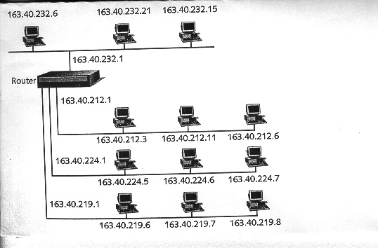
IP Subnet (3)
P.<number>
Notes:
CT212 (02/03)-Network Programming and design
27 April, 2002
School of Science & Technology

Slide 11
IP Subnet (4)
Refer to document
  “How to subnet.doc”
  “How to subnet_2.ppt”
P.<number>
Notes:
CT212 (02/03)-Network Programming and design
27 April, 2002
School of Science & Technology

Slide 12
Open
Discussions
P.<number>
Notes:
CT212 (02/03)-Network Programming and design
27 April, 2002
School of Science & Technology

